Slide 1
Indian Institute of Information Technology Una
GroundShield: Smart Earthing Safety System
By:-
Sanuj Bhagat(22248)
Shagun Yadav(22249)
Tisha Singh(22256)

Slide 2
Outline
01
Introduction
02
Motivation
03
Project Objectives
04
Innovation in the Project
Currently available
solutions
05
06
Work Progress and Demonstration

Slide 3
01
INTRODUCTION
Electrical safety is crucial in public installations like parking lots and station areas.
Manual earthing inspections are inefficient and require significant manpower.
GroundShield: A Smart Earthing Safety System that continuously monitors earthing parameters.
Utilizes IoT and sensors to detect earth leakage, continuity issues, resistance variations, and environmental factors.
Provides real-time alerts via buzzer, LED, mobile notifications, and a web dashboard.
Enhances safety and maintenance efficiency by enabling remote monitoring and automated fault detection.

Slide 4
02
MOTIVATION
Preventing Electrical Hazards: Unsafe earthing can lead to fatal electric shocks, fires, and equipment damage. A real-time monitoring system ensures early fault detection, preventing accidents.
Limitations of Manual Inspection: Traditional earthing checks require significant manpower and are not continuous. An automated system reduces dependency on manual labor and increases reliability.
Integration of Smart Technology: With the rise of IoT and AI-driven solutions, leveraging sensor-based monitoring brings intelligence to electrical safety, making it more efficient and proactive.

Slide 5
PROJECT OBJECTIVES
03
Monitor leakage current, overvoltage, short circuits, and earth continuity to prevent electrical hazards.
Provide real-time alerts (LED, Buzzer, IoT notifications) for immediate action.
Track soil moisture, soil temperature, air quality, and ground vibrations for better environmental assessment.
Transmit real-time data to a web-based dashboard for remote access.
Ultimate goal is to to develop a smart, automated, and reliable Earth Monitoring System that enhances safety, efficiency, and real-time decision-making.

Slide 6
04
INNOVATIONS IN THE PROJECT
Dual Monitoring System: Combines electrical and environmental monitoring in one unit.
Wireless Data Transmission: Uses web-based dashboard for real-time updates.
Remote Access & Control: Allows monitoring and control from a mobile app or web dashboard.
Cloud-Based Data Logging: Stores historical data for trend analysis and improved safety.
Modular & Expandable Design: Can be upgraded with additional sensors for more functionalities.
Energy Efficient: Optimized power usage with smart sleep modes for low power consumption.

Slide 7
05
CURRENTLY AVAILABLE SOLUTIONS
Earth Leakage Circuit Breaker (ELCB) & Residual Current Circuit Breaker (RCCB):
Detects leakage current and trips the circuit to prevent electric shocks and fires.
Limitation: Does not provide continuous monitoring and may fail silently over time.
Ground Resistance Measurement Devices (Earth Testers):
Uses earth resistance meters to manually test the grounding system at regular intervals.
Limitation: Manual, time-consuming, and periodic—faults may go undetected between inspections.

Slide 8
06
WORK PROGRESS AND DEMONSTRATION
Conducted a literature survey to understand existing solutions.
Understood the necessary components required for purchase.
Worked on the initial setup of the web dashboard.
Designed the circuit virtually and completed the component connections.

Slide 9
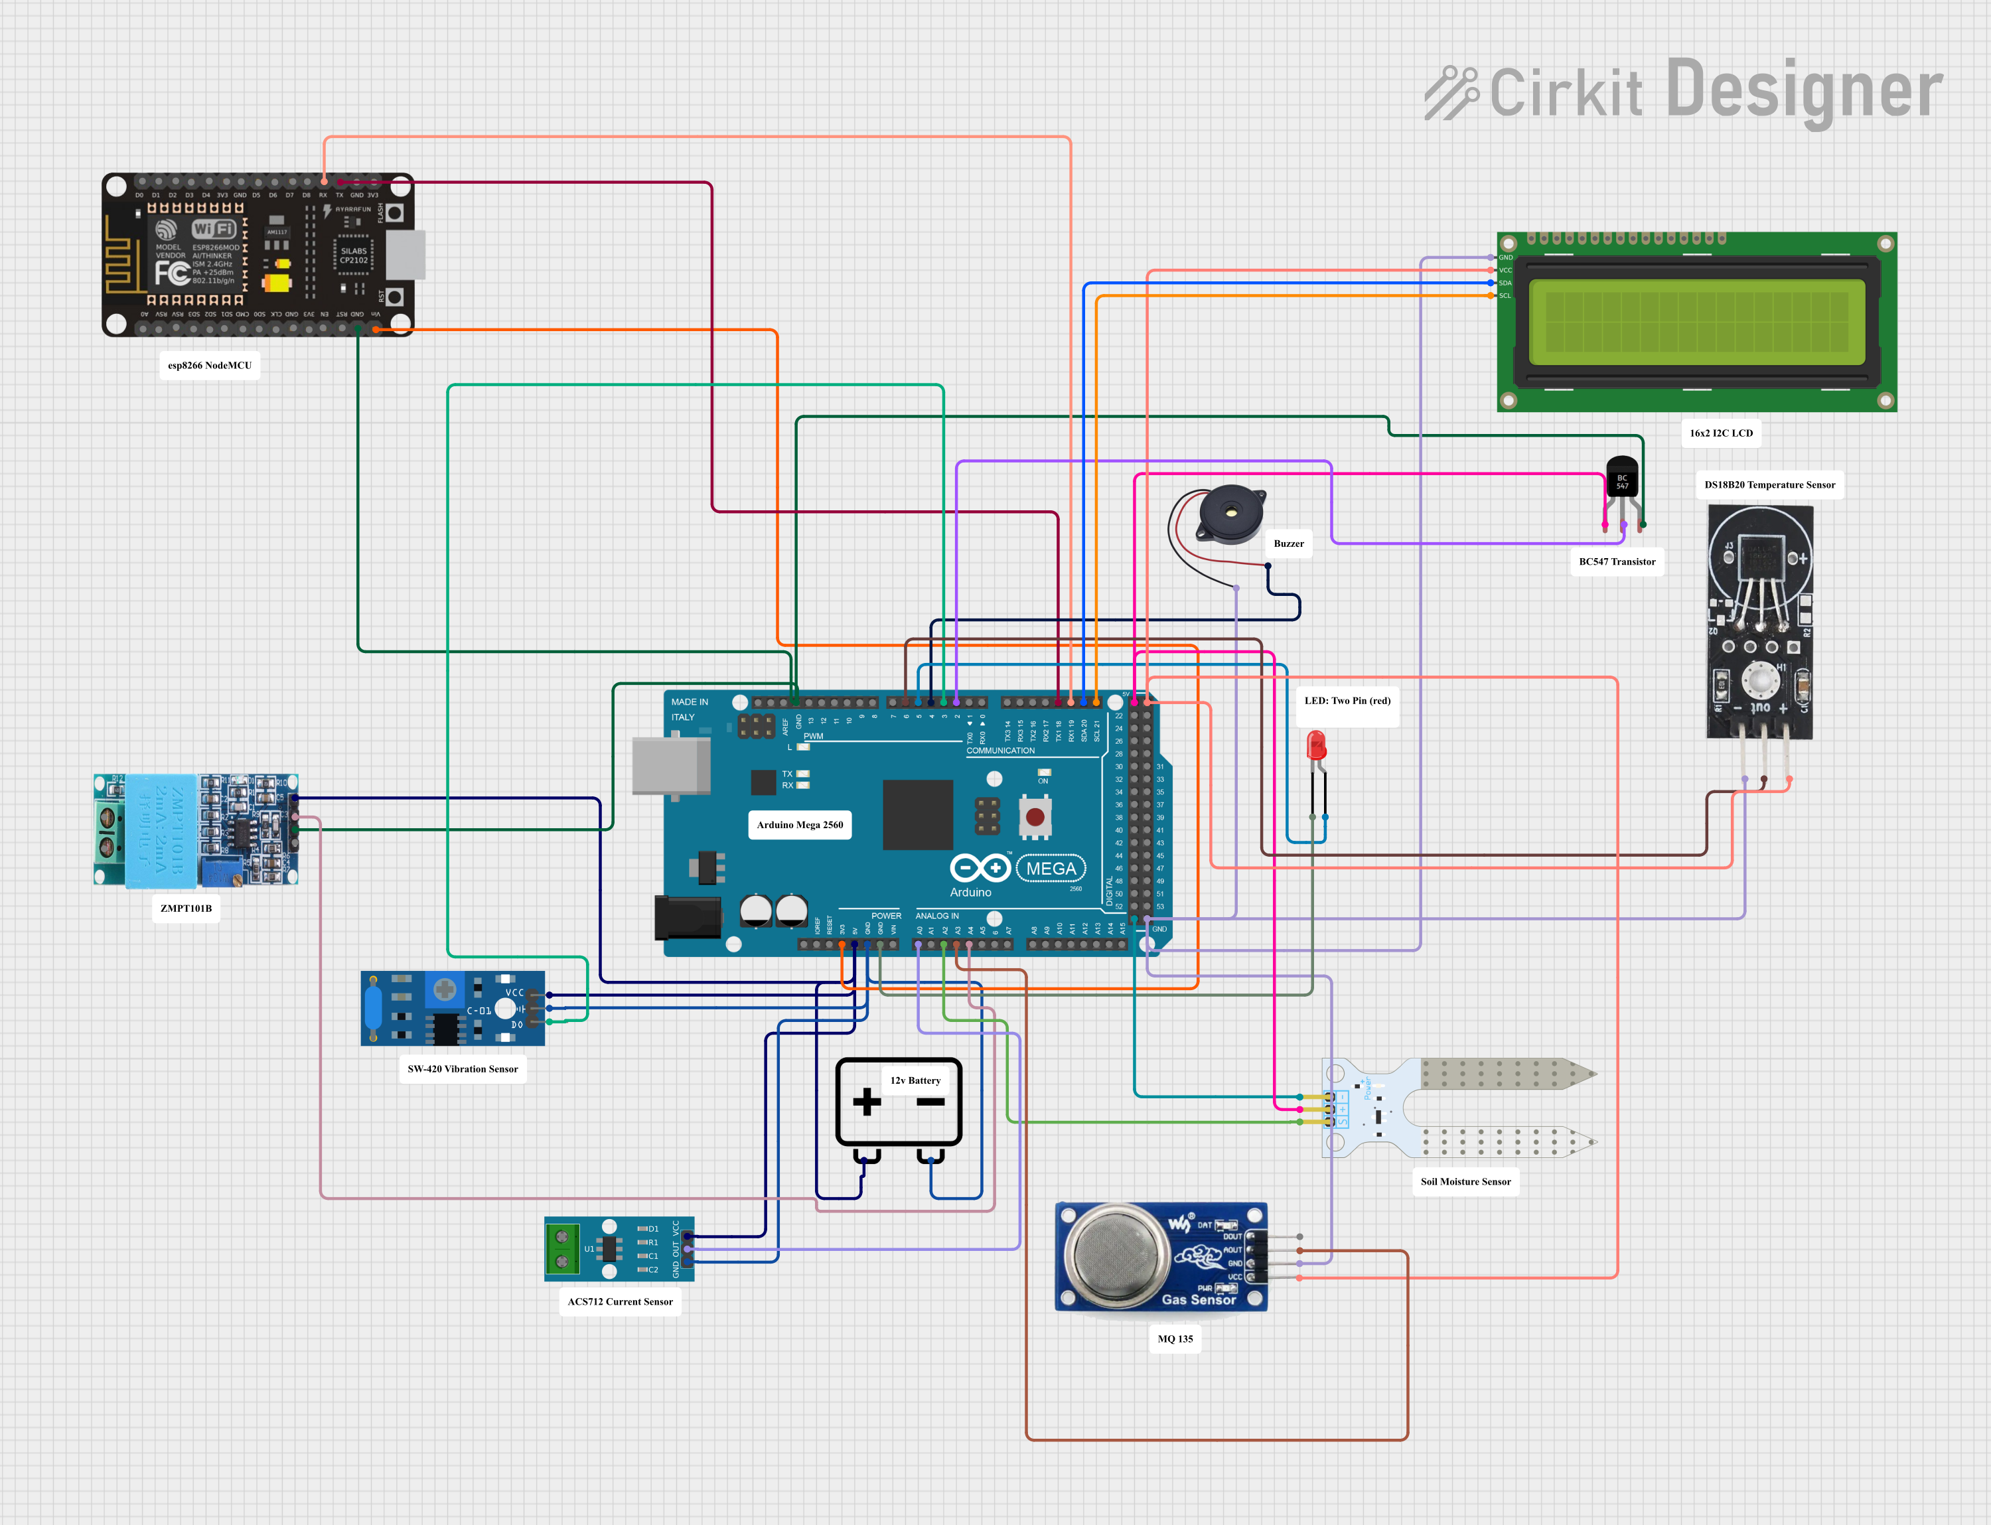
07
CIRCUIT DIAGRAM
.

Slide 10
Thanks! Questions and Answers

